Slide 1
DESIGN AND ANALYSIS OF ALGORITHMS
GRAPH ALGORITHMS
Submitted by-
Vishal Nagargoje
181210059

Slide 2
Table of Contents
Breadth-First Search Algorithm
Depth-First Search Algorithm
Minimum spanning tree
Kruskal’s Algorithm
Prim’s Algorithm
Single-Source shortest path(Dijkstra’s Algorithm)
All pair shortest path(Floyd Warshall Algorithm)

Slide 3
Breadth-First Search(BFS)
BFS is a traversing algorithm where we start traversing from a selected node (source or starting node) and traverse the graph layerwise thus exploring the neighbor nodes (nodes which are directly connected to source node). After traversing the visited nodes we go for the next nodes .
A graph can contain cycles, which may bring us to the same node again while traversing the graph. To avoid processing of same node again, we can use a Boolean array which marks the node after it is processed. While visiting the nodes in the layer of a graph, visited nodes are store them in a manner such that it can traverse the corresponding child nodes in a similar order.
We use a queue to store the node and mark it as ‘Visited’ until all its neighbors are marked.

Slide 4
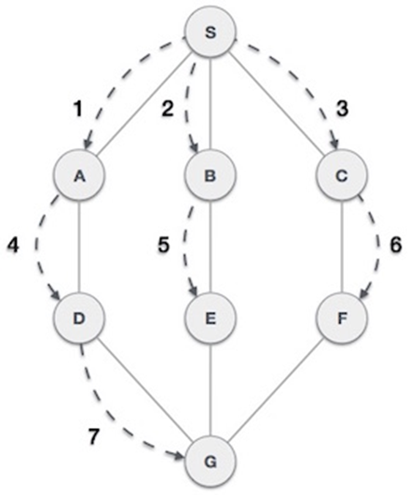

Slide 5
Pseudocode
BFS (G, s)
let Q be queue.
Q.enqueue( s )
mark s as visited.
while ( Q is not empty)
v = Q.dequeue( )
for all neighbors w of v in Graph G
if w is not visited
Q.enqueue( w )
mark w as visited.

Slide 6
Depth-First Search(DFS)
 Depth first traversal or Depth first Search is a recursive algorithm for searching all the vertices of a graph or tree data structure.
 A standard DFS implementation puts each vertex of the graph into one of two categories:
1). Visited
2). Not Visited
• The DFS algorithm works as follows:
 Start by putting any one of the graph's vertices on top of a stack.
 Take the top item of the stack and add it to the visited list.
 Create a list of that vertex's adjacent nodes. Add the ones which aren't in the visited list to the top of stack.
 Keep repeating steps 2 and 3 until the stack is empty.

Slide 7
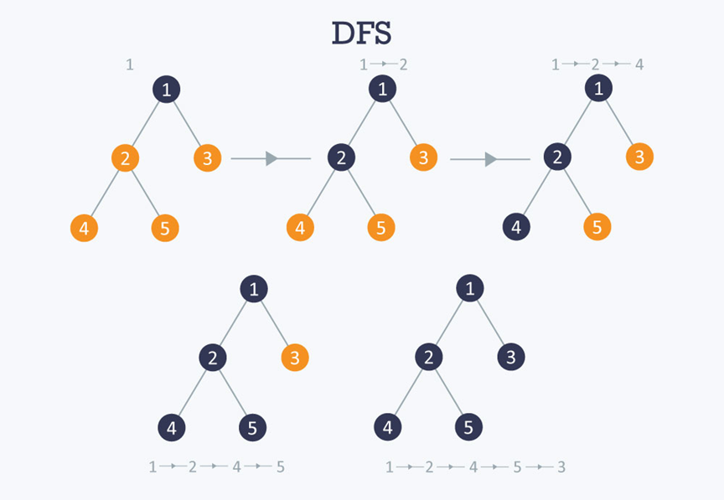

Slide 8
Pseudocode:
DFS-iterative (G, s):
let S be stack
S.push( s )
mark s as visited.
while ( S is not empty):
v = S.top( )
S.pop( )
for all neighbours w of v in Graph G:
if w is not visited :
S.push( w )
mark w as visited
DFS-recursive(G, s):
mark s as visited
for all neighbours w of s in Graph G:
if w is not visited:
DFS-recursive(G, w)

Slide 9
Minimum Spanning Tree
What is a Spanning Tree?
Given an undirected and connected graph G=(V,E), a spanning tree of the graph is a tree that spans G(that is, it includes every vertex of G) and is a subset of G(every edge in the tree belongs to G).
Minimum Spanning Tree:
The cost of the spanning tree is the sum of the weights of all the edges in the tree. There can be many spanning trees. Minimum spanning tree is the spanning tree where the cost is minimum among all the spanning trees. There also can be many minimum spanning trees.
Minimum spanning tree has direct application in the design of networks. It is used in algorithms approximating the travelling salesman problem, multi-terminal minimum cut problem and minimum-cost weighted perfect matching.

Slide 10
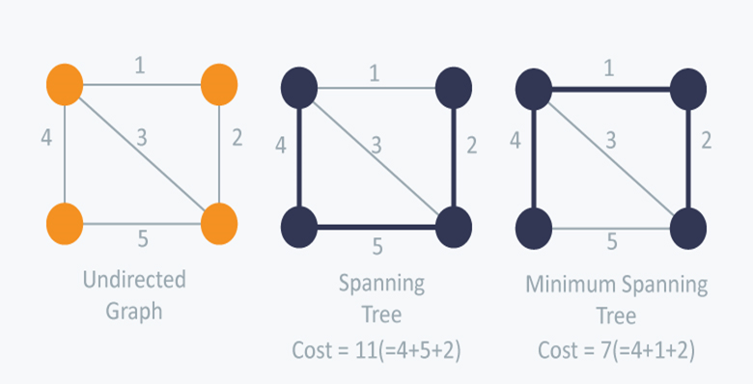

Slide 11
Algorithms for finding Minimum Spanning Tree
There are two famous algorithms for finding the Minimum Spanning Tree:
Kruskal’s Algorithm
Prim’s Algorithm

Slide 12
Kruskal's Algorithm
Kruskal’s Algorithm builds the spanning tree by adding edges one by one into a growing spanning tree. Kruskal's algorithm follows greedy approach as in each iteration it finds an edge which has least weight and add it to the growing spanning tree.

Slide 13
Algorithm Steps:
Sort the graph edges with respect to their weights.
Start adding edges to the MST from the edge with the smallest weight until the edge of the largest weight.
Only add edges which doesn't form a cycle , edges which connect only disconnected components.

Slide 14
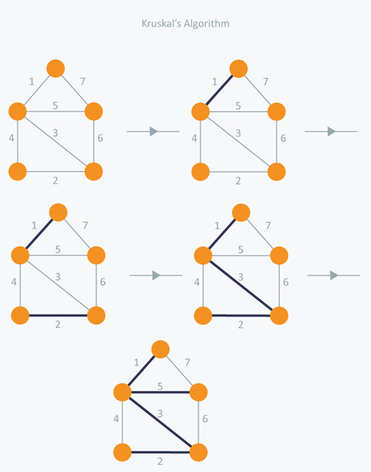

Slide 15
Prim's Algorithm
Prim’s Algorithm also use Greedy approach to find the minimum spanning tree. In Prim’s Algorithm we grow the spanning tree from a starting position. Unlike an edge in Kruskal's, we add vertex to the growing spanning tree in Prim's.

Slide 16
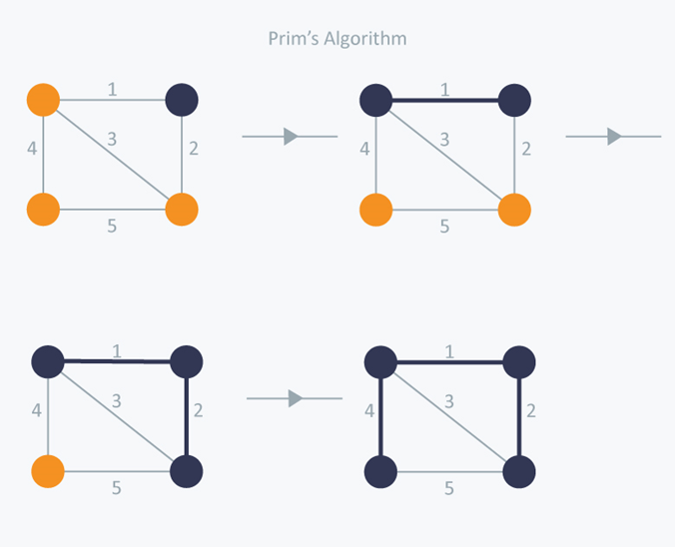

Slide 17
ALGORITHM
1) Create a set mstSet that keeps track of vertices already included in MST.
2) Assign a key value to all vertices in the input graph. Initialize all key values as INFINITE. Assign key value as 0 for the first vertex so that it is picked first.
3) While mstSet doesn’t include all vertices
….a) Pick a vertex u which is not there in mstSet and has minimum key value.
….b) Include u to mstSet.
….c) Update key value of all adjacent vertices of u. To update the key values, iterate through all adjacent vertices. For every adjacent vertex v, if weight of edge u-v is less than the previous key value of v, update the key value as weight of u-v

Slide 18
Shortest Path Problems
 In graph theory, the shortest path problem is the problem of finding a path between two vertices (or nodes) in a graph such that the sum of the weights of its constituent edges is minimized.
 There are two categories of shortest path problems
 Single-Source shortest path
 All- pair shortest path

Slide 19
Single-Source shortest path problem
In single-source shortest path problem, we have to find shortest paths from a source vertex v to all other vertices in the graph.
The algorithm used to solve this problem is known as ‘Dijkstra’s Algorithm’.

Slide 20
Dijkstra's Algorithm
•Dijkstra's algorithm has many variants but the most common one is to find the shortest paths from the source vertex to all other vertices in the graph.
•Algorithm Steps:
•Set all vertices distances = infinity except for the source vertex, set the source distance = 0.
•Push the source vertex in a min-priority queue in the form (distance , vertex), as the comparison in the min-priority queue will be according to vertices distances.
•Pop the vertex with the minimum distance from the priority queue (at first the popped vertex = source).
•Update the distances of the connected vertices to the popped vertex in case of "current vertex distance + edge weight < next vertex distance", then push the vertex
with the new distance to the priority queue.
•If the popped vertex is visited before, just continue without using it.
•Apply the same algorithm again until the priority queue is empty.

Slide 21
IMPLEMENTATION
#define SIZE 100000 + 1
vector < pair < int , int > > v [SIZE]; // each vertex has all the connected vertices with the edges weights
int dist [SIZE];
bool vis [SIZE];
void dijkstra(){
// set the vertices distances as infinity
memset(vis, false , sizeof vis); // set all vertex as unvisited
dist[1] = 0;
multiset < pair < int , int > > s; // multiset do the job as a min-priority queue
s.insert({0 , 1}); // insert the source node with distance = 0
while(!s.empty()){

Slide 22
IMPLEMENTATION(Cont.)
pair <int , int> p = *s.begin(); // pop the vertex with the minimum distance
s.erase(s.begin());
int x = p.s; int wei = p.f;
if( vis[x] ) continue; // check if the popped vertex is visited before
vis[x] = true;
for(int i = 0; i < v[x].size(); i++){
int e = v[x][i].f; int w = v[x][i].s;
if(dist[x] + w < dist[e] ){ // check if the next vertex distance could be minimized
dist[e] = dist[x] + w;
s.insert({dist[e], e} ); // insert the next vertex with the updated distance
}
}
}
}

Slide 23
All pair shortest path
•All-pairs shortest path algorithms follow this definition:
•Given a graph GG, with vertices VV, edges EE with weight function w(u,v)=w u,v return the shortest path from uu to vv for all u,v) in VV.
• The most common algorithm for the all-pairs problem is the Floyd-warshall algorithm. This algorithm returns a matrix of values MM, where each cell Mi,j​ is the distance of the shortest path from vertex i to vertex j. Path reconstruction is possible to find the actual path taken to achieve that shortest path, but it is not part of the fundamental algorithm.

Slide 24
FLOYD-WARSHALL’S ALGORITHM
•Floyd–Warshall's Algorithm is used to find the shortest paths between between all pairs of vertices in a graph, where each edge in the graph has a weight which is positive or negative. The biggest advantage of using this algorithm is that all the shortest distances between any 2 vertices could be calculated in O(V3), where V is the number of vertices in a graph.

Slide 25
ALGORITHMIC STEPS
•For a graph with N vertices:
•Initialize the shortest paths between any 2 vertices with Infinity.
•Find all pair shortest paths that use 0 intermediate vertices, then find the shortest paths that use 1 intermediate vertex and so on.. until using all N vertices as intermediate nodes.
•Minimize the shortest paths between any 2 pairs in the previous operation.
•For any 2 vertices (i,j) , one should actually minimize the distances between this pair using the first K nodes, so the shortest path will be: min(dist[i][k]+dist[k][j],dist[i][j]).

Slide 26
IMPLEMENTATION
for(int k = 1; k <= n; k++){
for(int i = 1; i <= n; i++){
for(int j = 1; j <= n; j++){
dist[i][j] = min( dist[i][j], dist[i][k] + dist[k][j] );
}
}
}

Slide 27
THANK YOU

